Slide 1
What if I still have to do a manual BILLING ADJUSTMENT?!
Notes:
Welcome to our presentation on how to complete insurance billing adjustments. Even though this is no longer the regular process, it continues to be a process in clean up issues and certain exception cases where we can’t catch the issue with the Workday system.

Slide 2
Warning! Possible Billing Adjustments
The Workday Arrears system takes care of most billing adjustments.
There could be situations that still cause a manual correction.
An employee terminates after being on leave and the arrears system can’t recollect outstanding premiums owed.
In that case you would follow the instructions for “Terminating Employee with Arrears” and fill out an Arrears Payoff form.
There could still be exception situations where you may still be asked to complete the old manual billing adjustment process.
Notes:
The Arrears system in Workday was set up to take care of many billing adjustment situations by pulling the missed premiums once the employee returns to work.
There are possibly situations where an employee is out on leave and then terminates without returning long enough to pull all the premiums owed.
There is a process for this situation. The process for this is explained in “Arrears Balances and Collection for a Terminating Employee” in the training materials on the website.
Even with both these processes, a situation could arise where you will be asked to complete a manual billing adjustment like was required prior to the Workday system.

Slide 3
Adjustment Forms
All forms are located: https://das.iowa.gov/human-resources/hr-info-hrapa#InsBillings
Billing Adjustment Forms
Arrears Forms
Health and Dental Forms
Life and LTD Forms
Training Materials
HRA Helps and Example Letters
Notes:
All the forms you will need to complete manual billing adjustments are located on the DAS website at das.iowa.gov/human-resources/hr-info-hrapa#InsBillings.

Slide 4
Manual Process for Exceptions
Notes:
Now we are going to cover the old manual process just in case you have some old clean up to do or an exception that can’t be done through the Workday system. This is rare, but still possible.

Slide 5
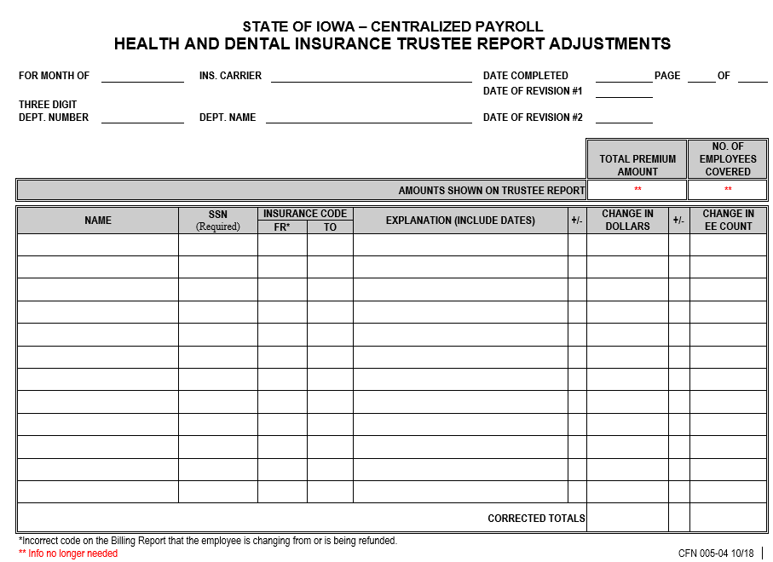
Cover sheet for all adjustments paying in or refunding.
Notes:
Let’s take a look at the different types of forms that we will be using to complete manual billing adjustments.
This is the Transfer Between Carriers form or TRA. It is used anytime you are adjusting funds in the health and dental accounts. Basically, this form would be used with most all of your health and dental adjustments.
This form is not required for Life or LTD adjustments.
You will do one TRA for each insurance carrier, National Choice, IA Choice, Delta Dental or SPOC Dental, for each month.
You can add as many employee’s adjustments onto one form as long as all the adjustments are for the same month and same carrier.

Slide 6
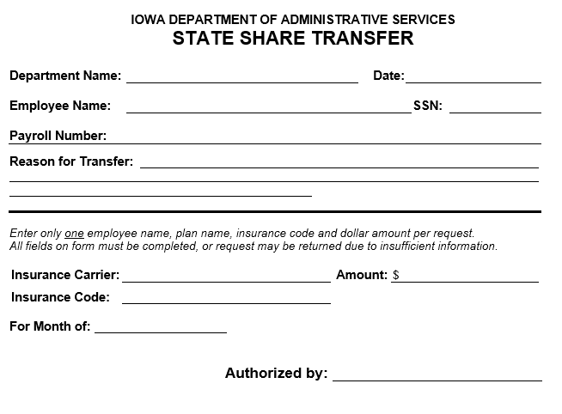
Used to pay in dollars owed by the department for state shares.
Notes:
This is the State Share Transfer form. It is used to pay in money owed by your department to cover any missed state share portions of the premium. Think of this like you are writing a check from your department to pay state share funds.

Slide 7
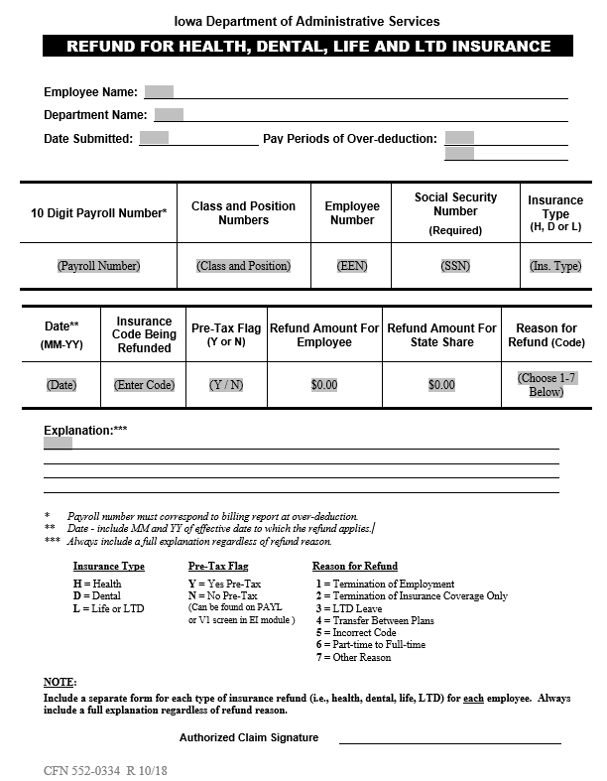
Used to refund money back to the employee or department.
Notes:
This is the Refund form. It is used anytime you need to receive funds back for an overpayment that was made. This form can be used for all insurances, health, dental, life and ltd.

Slide 8
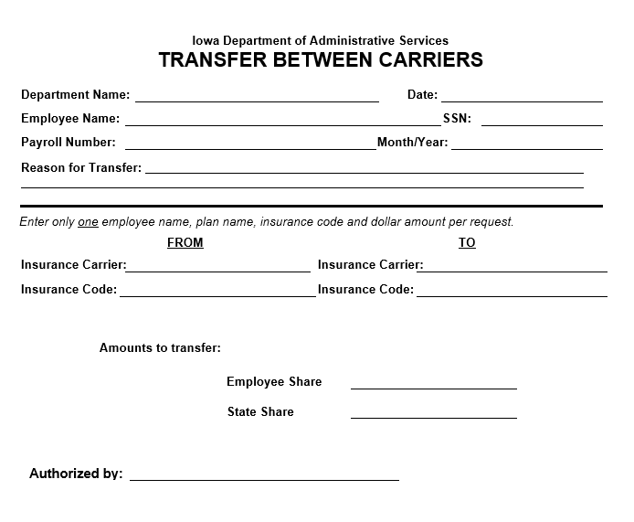
Used to transfer the common amount between two different carriers.
Notes:
This is the Transfer Between Carriers form. It transfers money that was previously paid to the wrong insurance carrier to the new insurance carrier account.
For example your employee changed to a new insurance carrier after funds were already paid for the month to their old carrier. The money would then need transferred to the correct funds.
This form is only used when you are actually transferring to a completely different insurance carrier (example: Iowa Choice to National Choice or Delta Dental to SPOC Dental) not just a change in plan, like from single to family with the same carrier.

Slide 9
Used to pay in dollars owed by the department for Life & LTD for those not in a leave code.
Notes:
This is the Life and LTD State Share Transfer form. It is used to pay in money owed by your department to cover any missed state share portions of the Life or LTD premium.
This form is only needed in cases where you did not have the employee in a leave code 53, 54, 57 or 59. If you had the employee in one of those leave codes when the premiums pulled, unlike health and dental, the state share has already been paid. You would not need this form which pays the state share.
Leave codes only pull the state shares of Life and LTD automatically. Health and dental adjustments will still need the State Share Transfer forms to pay the state share portion of those premiums.

Slide 10
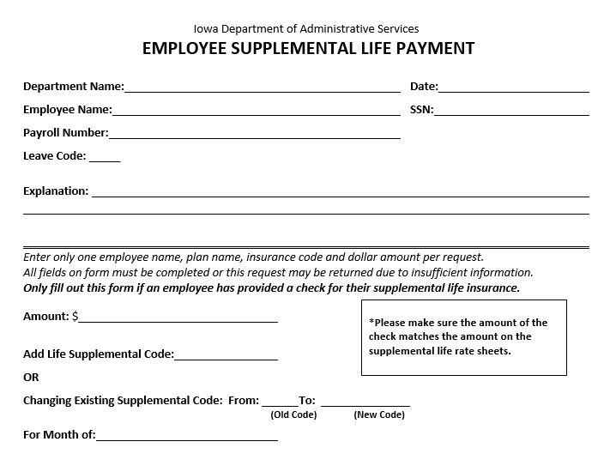
Use as an attachment to go with the payment when you are only sending in a check for Supplemental Life.
Notes:
This form is the Supplemental Life payment form. This form goes with any employee’s check you submit for supplemental life insurance. Since supplemental life is paid fully by the employee, you would only need to send the employee’s check and this form to provide the information to go with the check.

Slide 11
ADJUSTMENT EXAMPLES

Slide 12
Notes:
Lets start with adding someone to the billing.
Jessica needs the benefits of a break from Benefits.
On a well needed Florida vacation, she gets a little excited reliving the adventure of her favorite Disney princess.
Jessica falls out of her seashell boat on the Little Mermaid ride, hitting her head and breaking both arms.
Jessica is now out on FMLA LWOP.
Jessica has National Choice family.
Jessica is out on leave without pay and does not have a paycheck to deduct the insurance premiums from. She is FMLA covered, so she gets the state shares paid from her department.
Lets see what this adjustment would look like.

Slide 13
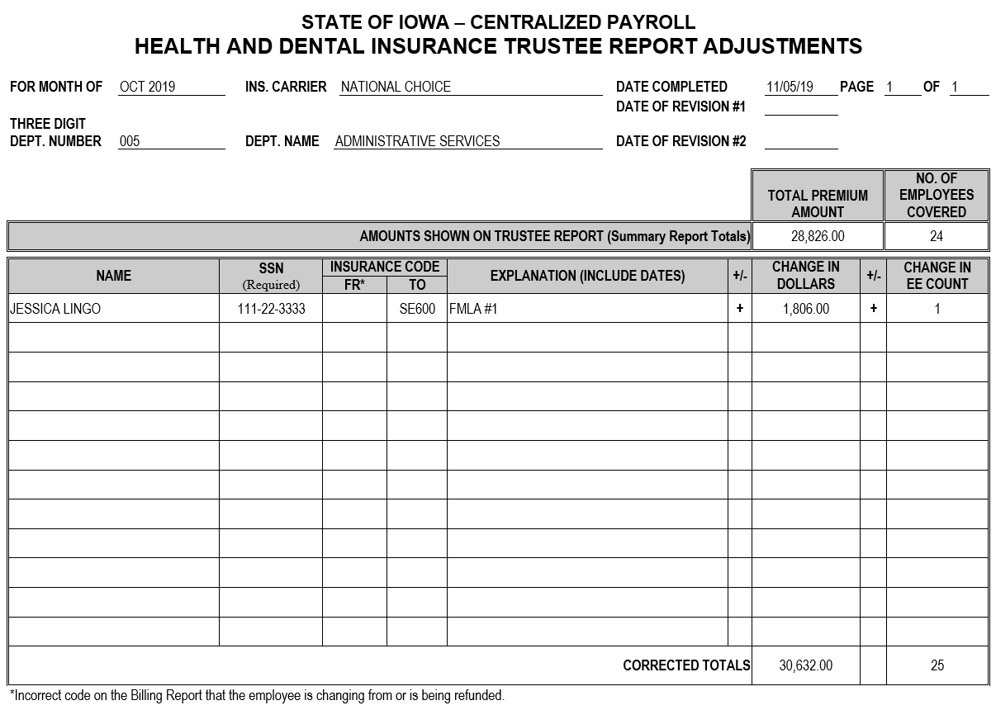
Notes:
You are going to need a TRA form.
At the top you will fill in:
The month that the adjustment is for. She missed her deductions for October, so the month we are adjusting is October.
The name of the insurance carrier is National Choice since that is the insurance she is enrolled in.
The date completed, is the date in which you are filling this adjustment out for submission.
The three digit department number.
The name of your department.
In the box section, you will fill in:
The amount shown on the trustee report. This is the Summary report total that you balanced to when you balanced your accounts for this particular carrier for the month.
The number of employees covered is also on your Summary report. The Summary report is report number 075-N193-A which comes in your monthly billing packet.
You will then add in the information for this adjustment on the lines below.
You will need the employee’s name, social security number, her insurance code that you are adding on to the billing (so it is in the “TO” column).
Add a brief explanation of why the employee needs added to the billing. In this case Jessica in on her first month of FMLA eligibility for insurance so we entered FMLA number 1 as an explanation.
Then, you will enter the premium dollars and employee count you are adding for this carrier. In this case, we are adding her whole premium to the billings since she had no insurance deductions and we are adding 1 employee to the counts for this carrier.
The new premium dollars and employee counts are then added to the National Choice totals from our balancing to get the new corrected total at the bottom.

Slide 14
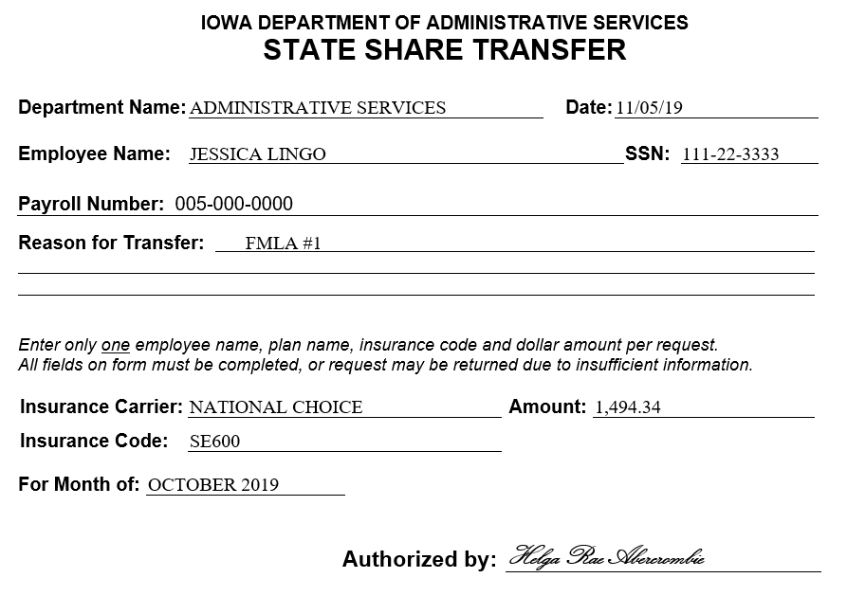
Notes:
For this adjustment, you are also going to need a State Share Transfer form in order to pay in the State’s share of the premium that was missed.
In this case, nothing has been paid yet so you would fill out this form for the entire state share of the premium.

Slide 15
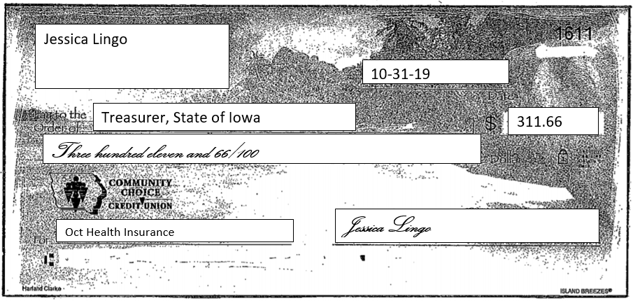
Notes:
The last piece of this puzzle is a check from the employee to pay the employee’s share of the missed premiums.
The employee’s check or money order needs to be written to the Treasurer, State of Iowa.
So, in order to add someone on leave to the billing who is eligible for the state shares, you need the TRA, a State Share Transfer form and a check from the employee.

Slide 16
Notes:
Let’s try another one. This time we will be refunding someone who had an insurance pull, but has already left employment and is not eligible.
With Jessica out during an especially difficult open enrollment, our fearless team leader must take on even more challenges.
The extra stress is too much for Amy.
Amy has a nervous breakdown and quits.
Amy quits on October 31st, but November insurance premiums have already pulled.
Amy has family Iowa Choice.

Slide 17
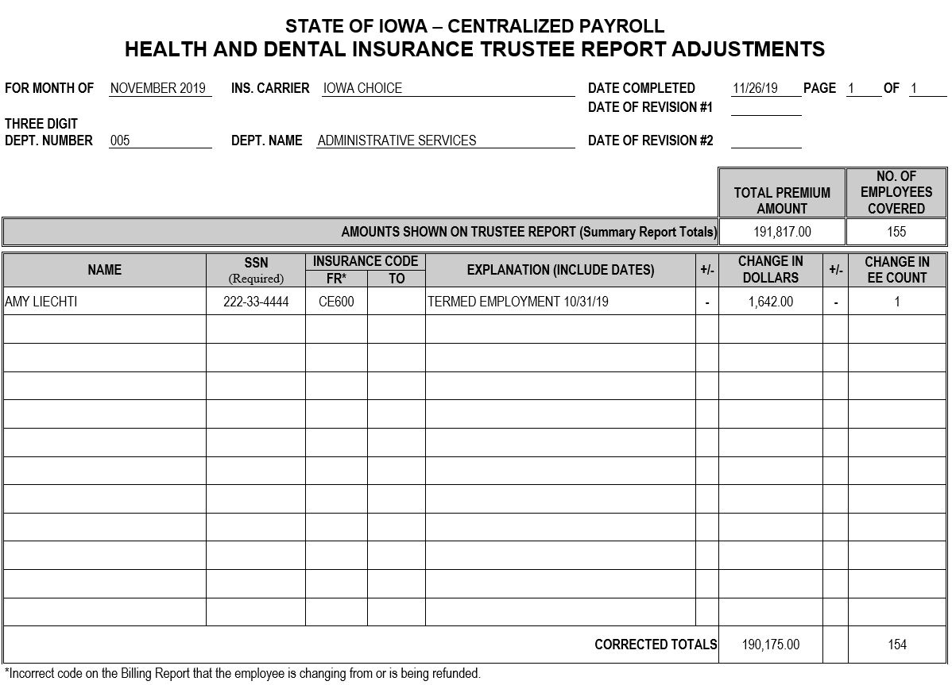
Notes:
Again, you need the TRA form to sum up the situation and update the dollars and number of employees.
Unlike the first example, this time the employee has left employment and doesn’t need to be on our billing for the month of November.
For this adjustment, we will fill out most of it the same, only this time Amy’s insurance code goes in the from column “FR”, since we are taking the code from the billing and we will subtract the amounts.
We are deducting the entire premium and one employee from the counts. These numbers are now negative.

Slide 18
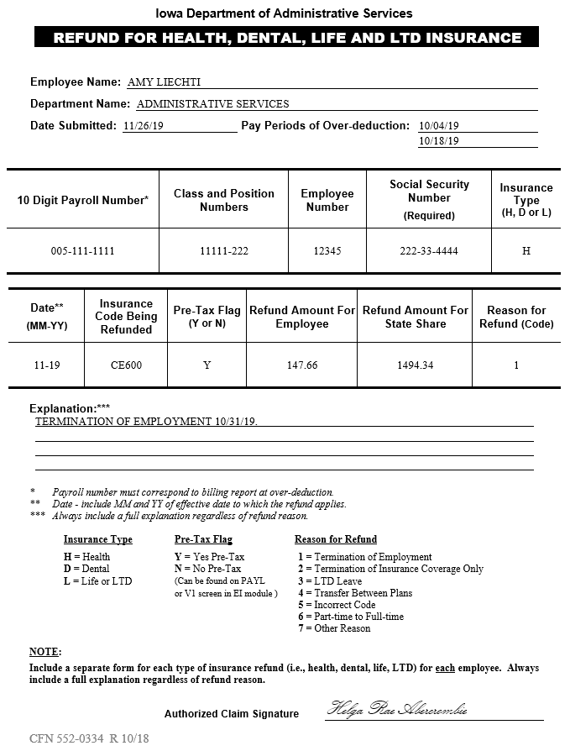
Notes:
Since we are refunding the premium, we need a Refund form instead of a pay form.
In the boxes, break out the 18 digit payroll number into two parts, the first ten digits in the first box and the class and position numbers (the last 8 digits) in the following box.
Enter the employee number and the social security number in the next two boxes.
“Insurance Type” is just an H, D or L to represent health, dental, life or LTD. You can use L for both life and LTD.
The “Date “ box is the month and year that the premiums are being refunded for.
The “Insurance Code Being Refunded” is the code that caused the overpayment or the code they are going “out” of if they are being refunded due to going to a cheaper plan.
The pre-tax flag can be found in HRIS in the Employee Information Module on the V1 screen.
In the next two boxes, insert the refund amount for the employee share and the state share. Enter zero if there is none for that portion of the premium.
In the final box enter the reason code from below. Use the number that comes closest to the reason or use “Other”.
Fill in the explanation lines telling what the refund is for.
Remember to sign the form.

Slide 19
Notes:
This time lets do an adjustment to switch between two codes.
Elise likes to walk her dog at the dog park.
Her pup decides a pesky little squirrel wants to play.
In the scurry, Elise trips into the arms of a cute dog lover nearby.
Puppy love gets serious and Elise gets married.
Elise goes from single Iowa Choice to family Iowa Choice.

Slide 20
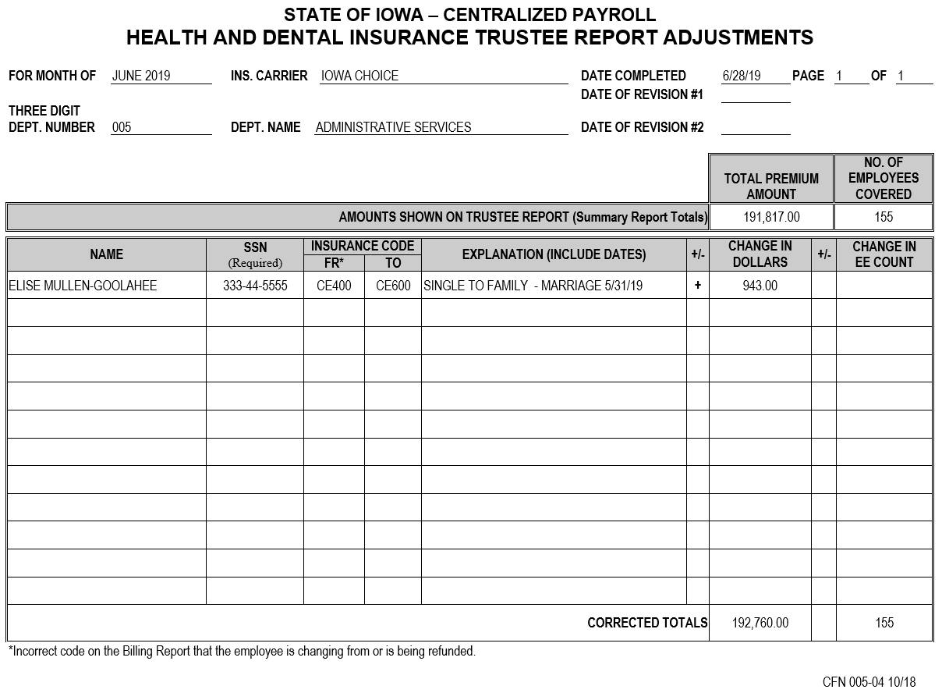
Notes:
As usual, you will need a TRA form. This time, you will have both a from and to code in the “Insurance Code” columns as Elise is going from the single code to the family code.
The change in dollars in the column on the right, will only be the difference between to total premium for the single code and the family code.
You will not need to add a change in the employee count because Elise is already in an Iowa Choice plan.

Slide 21
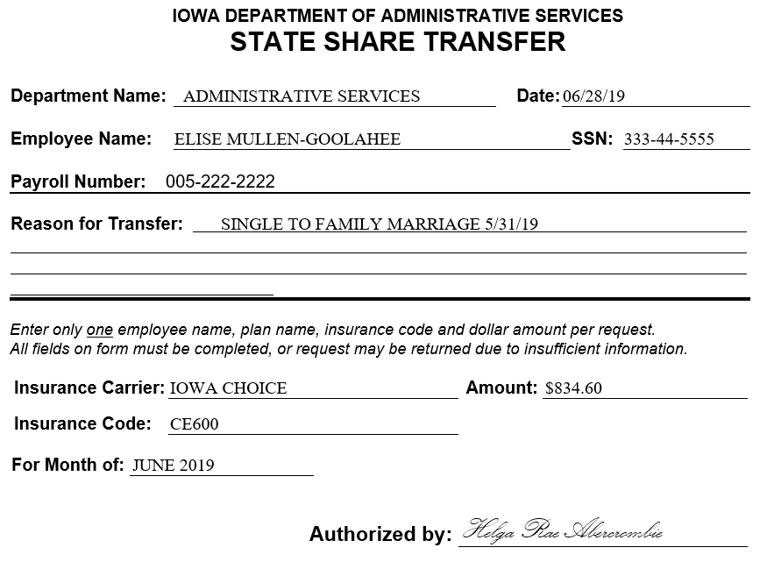
Notes:
You will need a State Share Transfer to pay in the difference still owed since only a single premium was paid and the state share portion of the premium was underpaid.
In this case, the amount on the State Share Transfer will be the difference between the state share portion of the single premium and the state share portion of the family premium.
The insurance code for this form will be the new, more expensive code that you are paying the extra amount to cover.
Make sure to add your name on the “Authorized by” line.

Slide 22
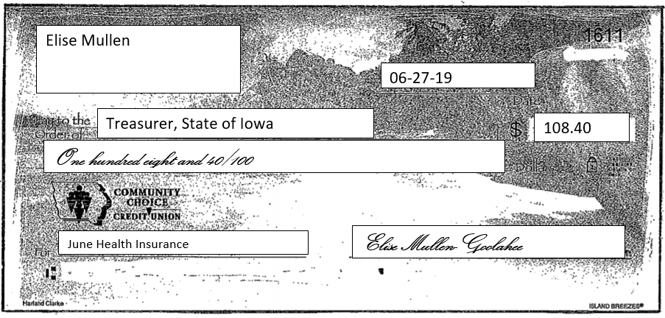
Notes:
You will also need a check from the employee written to the Treasurer, State of Iowa for the difference in the employee share of the premium which was underpaid.

Slide 23
Notes:
Now, we will go through an example of someone changing from one insurance carrier to a different one.
Six hours of basketball every day is a little too much for Sandy.
Sandy and Jim get divorced due to the NBA Playoffs.
Sandy goes from Family National Choice to single Iowa Choice.

Slide 24
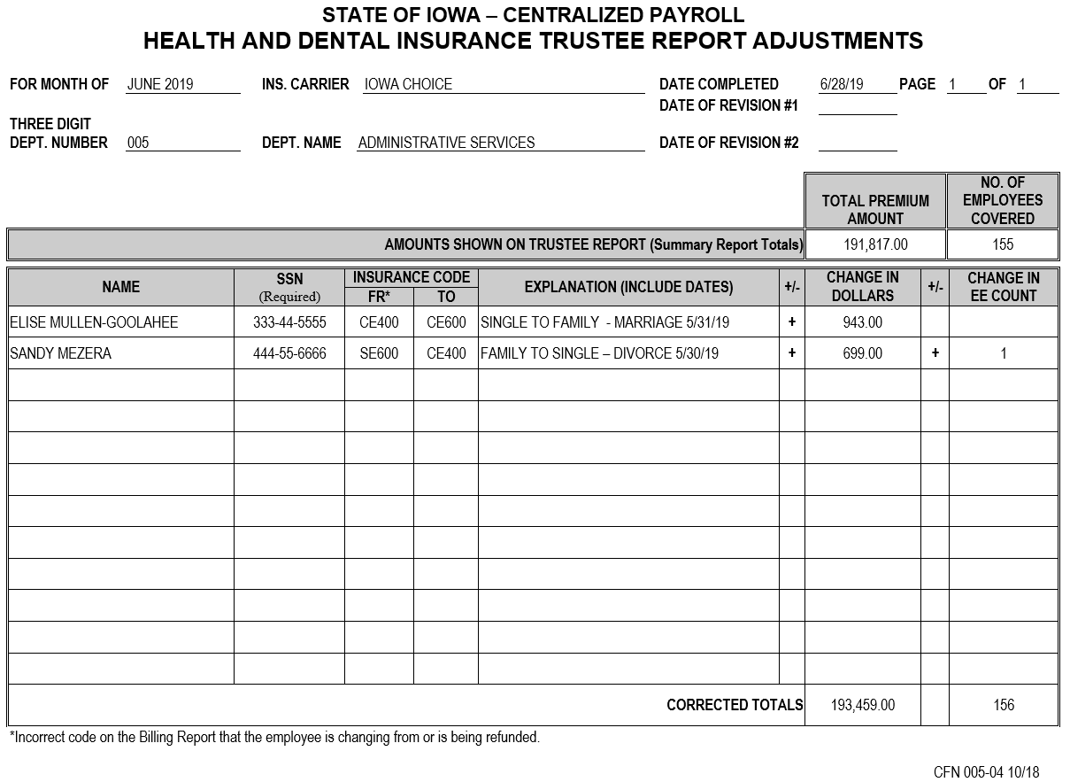
Notes:
For adjustments like this, you need to consider both sides of the issue. You need to adjust both carriers.
We will start with Iowa Choice.
You will notice since Sandy’s adjustment was for the same month and carrier as Elise’s, they can both be added to the same TRA form.
In this case, Sandy is going from National Choice to Iowa Choice. This is the TRA for Iowa Choice, so the change in dollars and employee count would be positive since we are adding Sandy to the Iowa Choice billing.
The dollars you should be adding would be the entire premium for the code CE400.

Slide 25
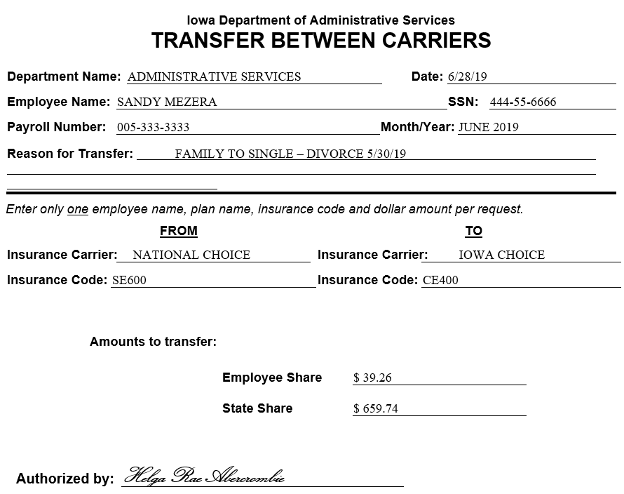
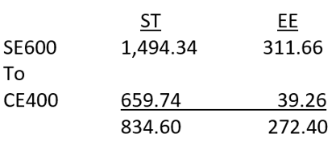
Notes:
You will need the Transfer Between Carriers form.
When filling out a Transfer Between Carriers form, you will need to consider the dollar amounts that are needed and what has already been pulled.
In this case, the premiums that already pulled and went to the National Choice account are more than the premiums needed to pay what is owed to the Iowa Choice account.
You only need to transfer the amounts needed to pay the new carrier. The rest will be refunded out. So in this case, the amounts for your Transfer Between Carriers form would be $39.26 for the employee share and $659.74 for the state share with the rates shown on the slide.

Slide 26
Notes:
Now, we need to take care of the other side. Since you are taking funds away from National Choice, you need a TRA form showing the transfer from National Choice to Iowa Choice with the change in dollars and employee count being subtracted from your totals. In this case the full SE600 premium rate will need to be subtracted since it is all being transferred or refunded out.

Slide 27
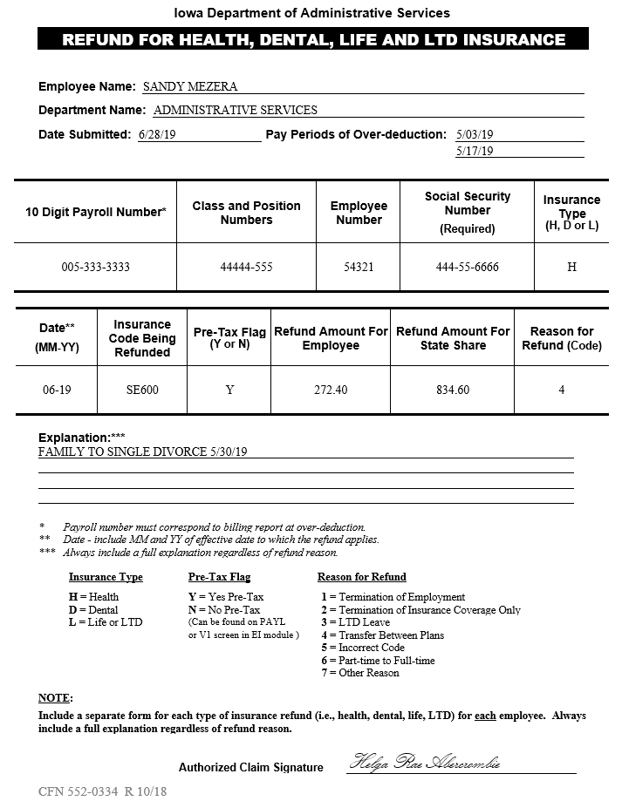
Notes:
You will need the Refund form to refund out the remainder that you didn’t need to transfer to pay the Iowa Choice rate.
Since you had already pulled $1,494.34 for the state share, $659.74 is being transferred to Iowa Choice since that is the state share premium owed for that. The $834.60 that you don’t need is the amount we are refunding here on the Refund form. That is the same with the employee share. We transferred the $39.26 we needed and we are refunding the $272.40 extra that we don’t need.
Don’t forget to sign the bottom Signature line.

Slide 28
COPY
Notes:
The last thing to include on this side of your adjustment is a copy of the Transfer Between Carriers form that you did for the Iowa Choice side.
This just shows that you transferred the rest of the money out of the plan. We don’t need another set of original forms. You only need to do this one once for both sides of the transfer.

Slide 29
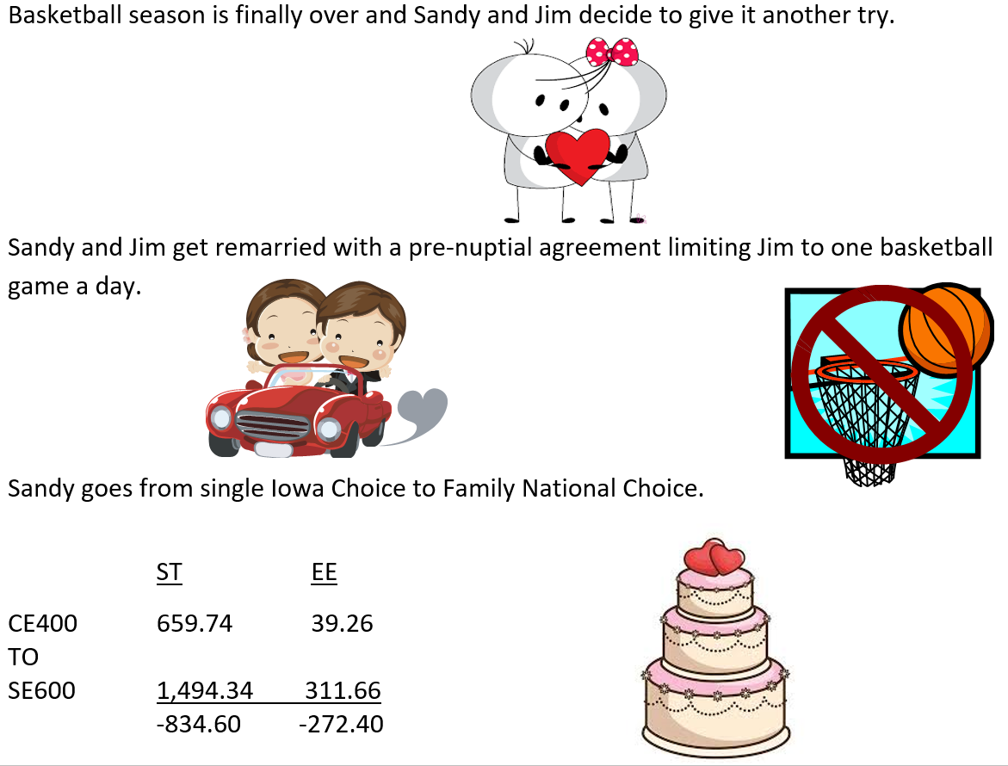
Notes:
Now lets reverse our transfer between carriers situation and try this one in a situation where the employee is going from a cheaper plan to a more expensive plan.
Basketball season is finally over and Sandy and Jim decide to give it another try.
Sandy and Jim get remarried with a pre-nuptial agreement limiting Jim to one basketball game a day.
Sandy goes from single Iowa Choice to Family National Choice.

Slide 30
Notes:
Again, we need the TRA form for National Choice.
This time our National Choice changes are positive since we are going to National Choice as our new carrier.

Slide 31
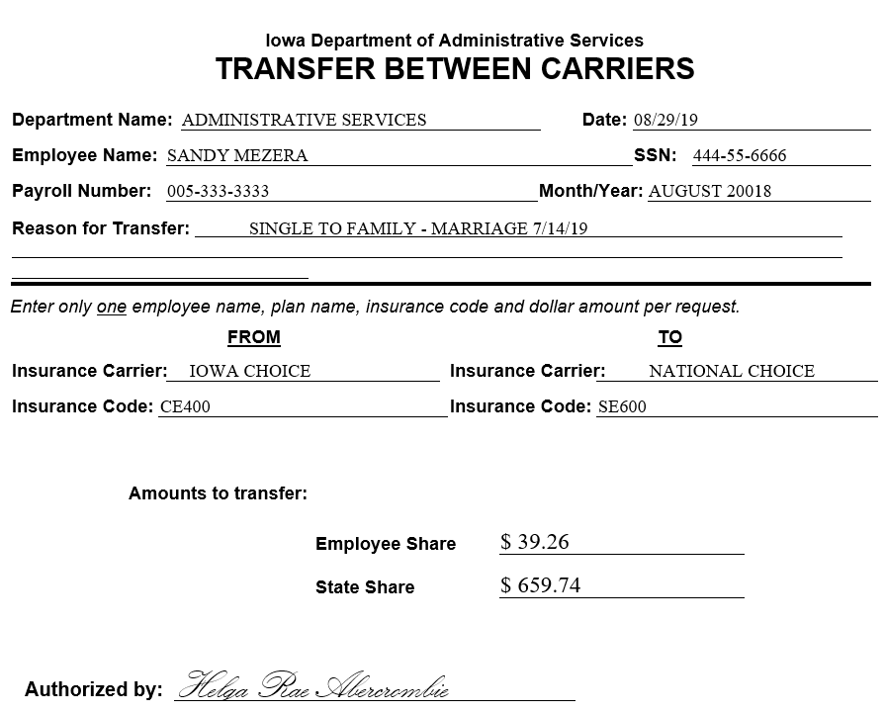
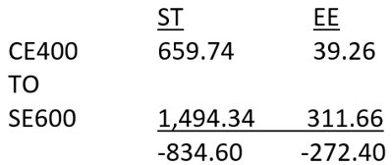
Notes:
We need the Transfer Between Carriers form to transfer the common amounts we need to the new carrier.
In this case, the amounts are still $39.26 employee share and $659.74 state share for the transfer.
This time, not because that is all we need but because it is all that we have already pulled to transfer this time around.

Slide 32
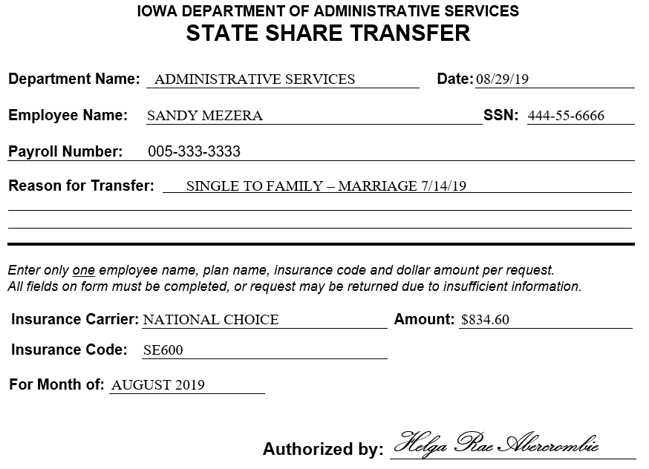
Notes:
This time we are going to a more expensive plan so we still owe money for the premium to the new carrier.
Instead of a Refund, we will need a State Share Transfer form to pay in the difference between what was already pull and what is now owed.
In this case once we transferred the state share portion that we needed, we still owe $834.60 for the new premium amount.

Slide 33
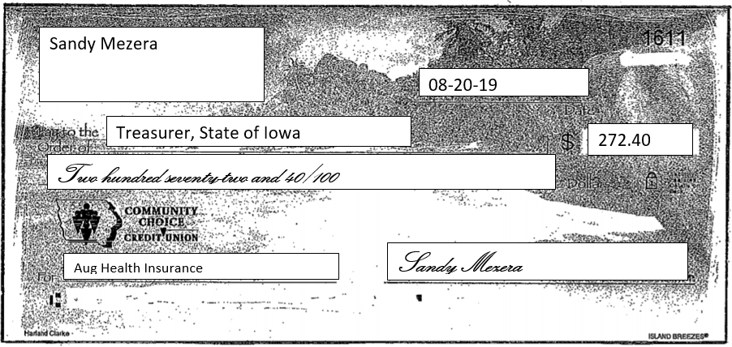
Notes:
Since there is a short payment of the employee share of the premium as well, we need a check from the employee for the difference between the two employee share premiums.

Slide 34
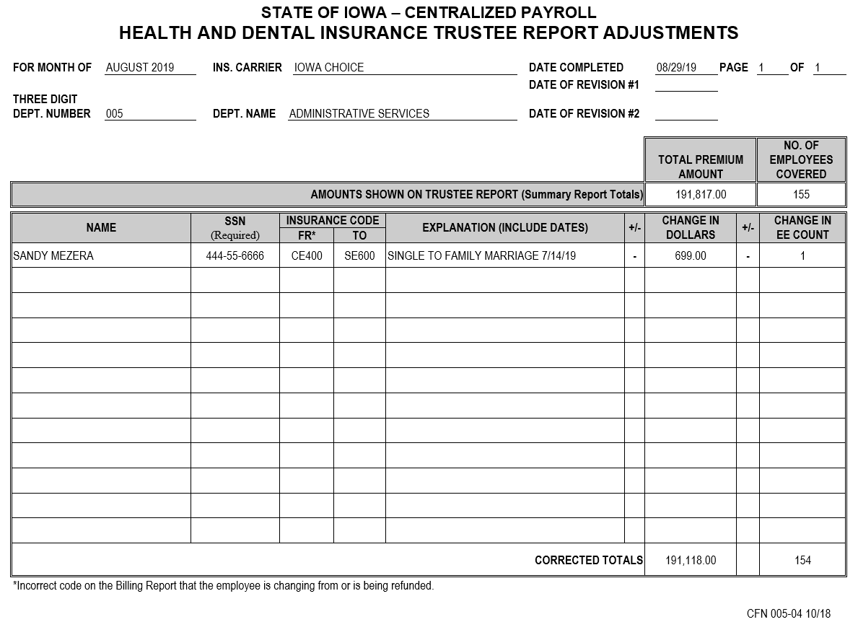
Notes:
Now the other side.
We need a TRA for Iowa Choice as well, showing the premium dollars that are being transferred being subtracted from the Iowa Choice account.

Slide 35
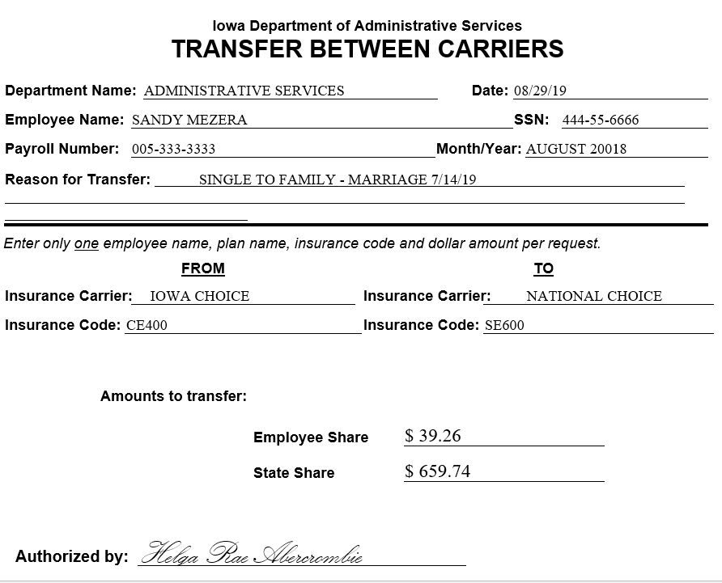
COPY
Notes:
Since the Transfer Between Carriers form is for the entire amount of the Iowa Choice premium this time, all we need to go with the TRA form is a copy of the Transfer Between Carriers we did on the National Choice side.

Slide 36
Submission Of Adjustments
All checks and money orders should be written to the State of Iowa.
Send originals and one set of copies.
Submit forms, payments and set of copies to:
Insurance Billings
DAS SAE
3rd Floor Hoover Building
Notes:
When you have balanced and finished putting together your billing adjustments for a month, you will need to submit the packet to the Department of Administrative Services.
Every month you should submit the Summary report that you received in your insurance report packet. On this sheet you will have checked off each account that you balanced and if adjustments are included for that carrier.
You will include any billing adjustment you have completed for the month.
You will need to submit the original forms and checks and one set of copies. Also keep a second set of copies for your records.
Remember that all checks should be written to the “State of Iowa”, not to the department or the insurance carrier.
You will send this packet of forms, payments and copies to “Insurance Billings DAS-SAE 3rd Floor Hoover Building”.

Slide 37
Need Help? Have Questions?
Remember, the training materials, worksheets and forms are on-line at:
https://das.iowa.gov/human-resources/hr-info-hrapa#InsBillings
Email or Call Sandy Mezera at Sandy.Mezera@iowa.gov/ 515-281-8999
Notes:
Need Help? Have Questions?
Our library of training materials available on the web-site will continue to grow. The worksheets and forms you will need are located there for your use as well.
If you have questions, feel free to contact me, I would be glad to help.

