Slide 1
2020 Changes to FSA Accounts

Slide 2
Overview
The COVID pandemic has brought about changes to the flex plans:
OTC
Deadline Extensions
Enrollment/Changes

Slide 3
otc
Permanent change
Over-the-counter drugs/medicines no longer require prescription
Menstrual items are now eligible expenses

Slide 4
Deadline extensions
2020 Change Only
Submit 2019 claims using 2019 $
Dep Care and Healthcare FSA
Until 60 days after emergency ends
Submit 2020 claims using 2019 $
Dep Care only
Extends grace period until 12-31-2020

Slide 5
enrollment / changes
2020 Change Only
Can enroll or make changes at any time
No life event needed
Make changes in
Health FSA – “other change”
Dep Care FSA – “day care change”

Slide 6
processing
2020 Change Only
New enrollees
Coverage begins month after enrollment
Remaining pps – don’t include 3rd cks
Claims incurred prior to coverage begin date not valid
Example 1
Jessi enrolls 6/16
Coverage begins 7/1
12 pps
Example 2
Sam enrolls 7/1
Coverage begins 8-1
10 pps

Slide 7
processing
2020 Change Only
Existing enrollees
EEs may increase, lower or cancel
When increasing election
include in annual election the amount already contributed
Increased $ only for claims incurred after effective date
Changes effective month after submitted in IB
Remaining pps
leave as original pps (generally 24)
ASI makes own calculations

Slide 8
processing
Examples of One Change
Dependent Care
Craig elects $5000 for 1/1
Change Example 1
6/16 – lowers to $3000
Change effective 7/1
24 pps
Change Example 2
6/16 – lowers to $1000
Lowest allowed is $2500.08
Change effective 7/1
24 pps
Healthcare
Ann elects $1200 for 1/1
Change Example 1
6/16 – cancels coverage
Change effective 6/30
Watch date
Change Example 2
6/16 – increases to $1500
Change effective 7/1
24 pps

Slide 9
processing
Examples of Two Changes
Craig elects $5000 for 1/1
Example 1
6/16 – lowers to $2500.08
Contributes $2500.08 thru June
No new contributions, still has coverage
8/25 – wants $2000 for rest of yr
Changes election to $4500.08
Changes effective 9/1
24 pps
Example 2
6/16 – cancelled coverage
Contributes $2500.08
No coverage as of July 1
8/25 – wants $2000 for rest of yr
Re-enrolls – elects $4500.08
Change effective 9/1
Coverage effective Jan-June and Sept-Dec
24 or 20

Slide 10
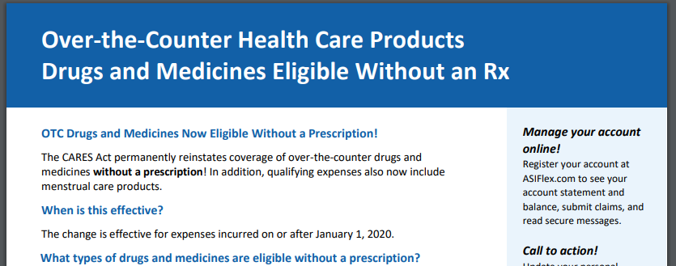
resources
RIC website
ASI website
HRExpress articles
10

Slide 11
Questions?

