Slide 1


IMPACS
User Guide for Vendors

Slide 2
Overview
Ctrl + Click to jump to a slide
What is IMPACS?
Why Should I Register?
Registration FAQ
How do I Register?
Completing your profile
Adding Users
Finding Events
Responding to Events:
        Access Two Ways
        Log In
        Required Fields
        Amendments
        Q&A
        Returning to an Event
        Support

Slide 3

What is IMPACS?
Iowa
Management of
Procurement
And
Contracts
System
The State of Iowa uses IMPACS for electronic bidding and contracting
IMPACS is a JAGGAER product

Slide 4

Why Should I Register?
While anyone can view bids on our public site, you must be registered to:
Respond to bid opportunities
Receive automatic bid notifications for your selected commodity codes
Tip: Buyers also use the IMPACS vendor database to find vendors for purchases under the competitive threshold

Slide 5
Registration FAQ
Can I forward my registration invitation?
Yes, you can forward the invite to anyone in your company. However, once a username and password are created, the invitation cannot be forwarded. Add Users to your account once you’re logged in.
What if our primary contact is no longer with the company?
Submit a ticket to JAGGAER Supplier Support. Include your company’s Tax ID Number to verify that you’re with the company and that the correct company profile is being edited.
What does JAGGAER do with my information?
Your information is securely stored and only accessible to select JAGGAER and Procurement staff. It will not be sold or misused.
What is “DBA”?
“Doing Business As,” a name under which a corporation operates that differs from its legal name.
Who can I contact for more questions on registration?
Contact the State at impacs@das.iowa.gov or JAGGAER Supplier Support by clicking the link or calling 1-800-233-1121, available 7:00 am to 7:00 pm CT, Monday-Friday.

Slide 6
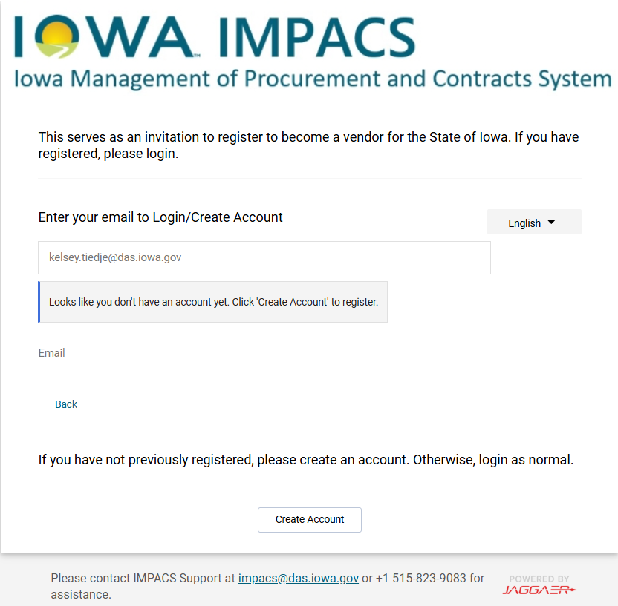
How do I Register?
First, verify that your company does not have an existing account.
Unsure? Reach out to IMPACS@das.iowa.gov or 515-823-9083.
Start here: Vendor Portal
Enter your email and click Next
  If you have an account, enter your password OR click Trouble Logging In?
  If you don’t have an account, it will prompt you to Create Account
1
2

Slide 7
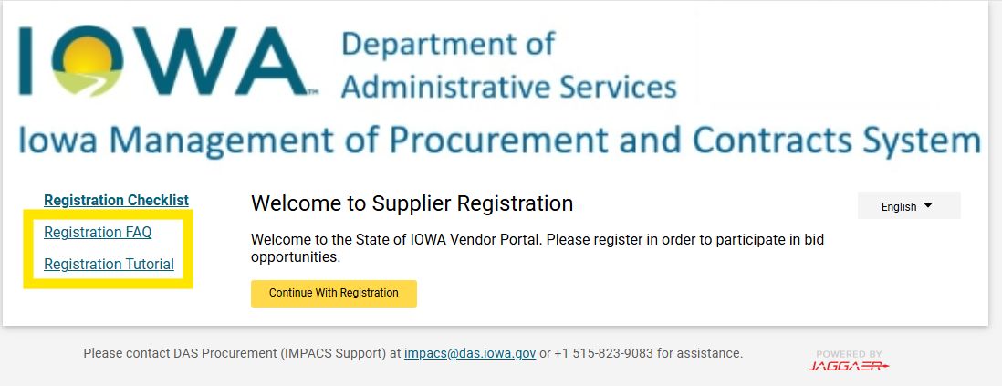
Registration
3
Access resources on the left, or Continue With Registration
4
Enter required fields. Please note:
Do not enter dashes for Tax ID (EIN or SSN)
Iowa is on CDT/CST – Central Standard Time (America/Chicago)

Slide 8
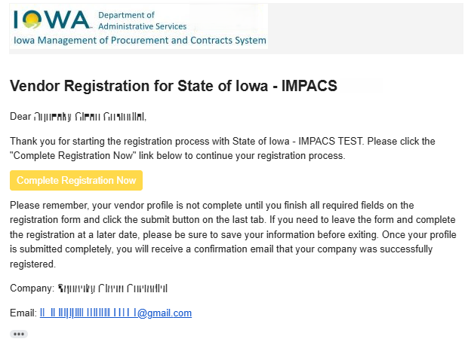
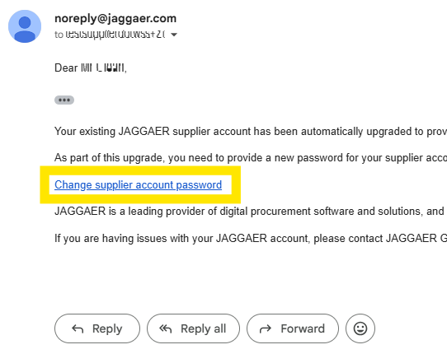
Registration
5
Validate Account
You will receive an email with a link to Complete Registration Now
6
Get Password Link
Check your email for a link to Change supplier account password

Slide 9
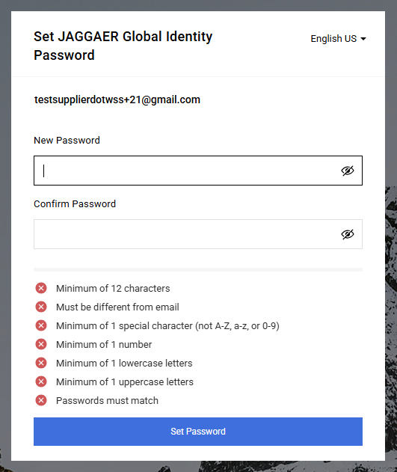
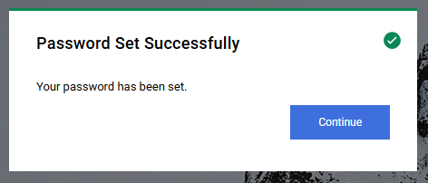
Registration
7
Set Password and Continue
Tips:
Check spam for security codes and password reset links. It may take a few minutes
Always use the most recent code

Slide 10
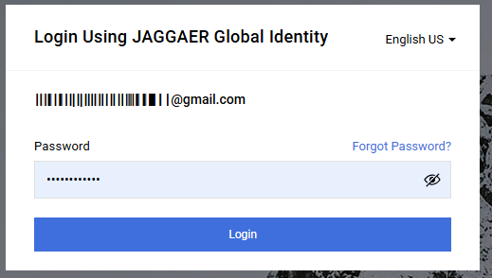
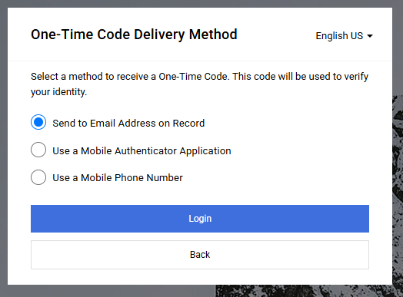
Registration
Log in
9
Send Yourself a One-Time Code and enter it on the next screen
8
Issues? Contact support:
DAS 515-823-9083 impacs@das.iowa.gov
Jaggaer 1-800-233-1121
    Jaggaer online support

Slide 11
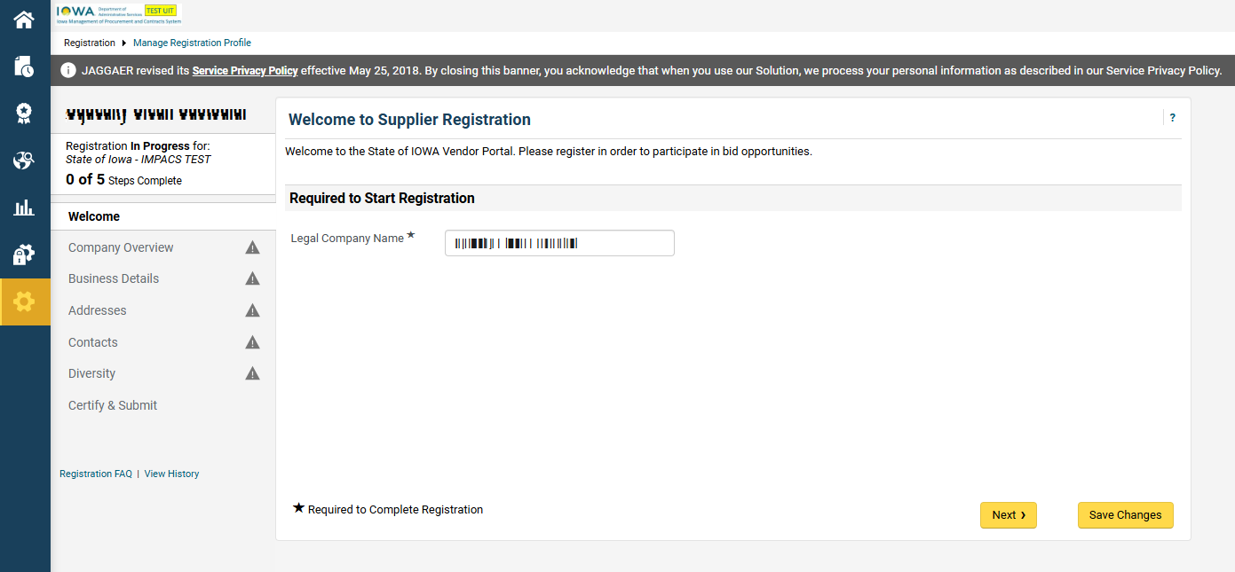
Completing your profile
Navigate through tabs on the left
1
2
Be sure to save changes
Tip: You can return to your profile later from the portal home screen

Slide 12
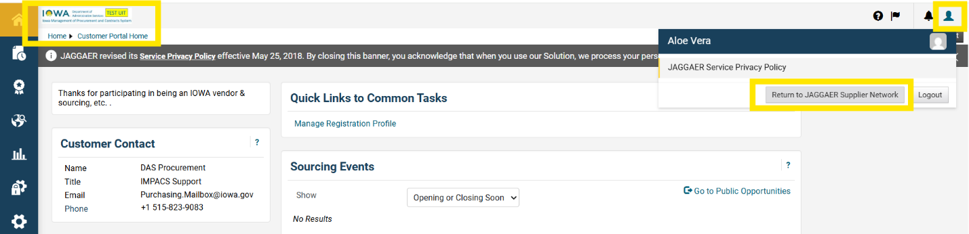
Adding Users: access the JSN
Manage your account on the Jaggaer Supplier Network (JSN)
Access the JSN from your IMPACS account

Slide 13
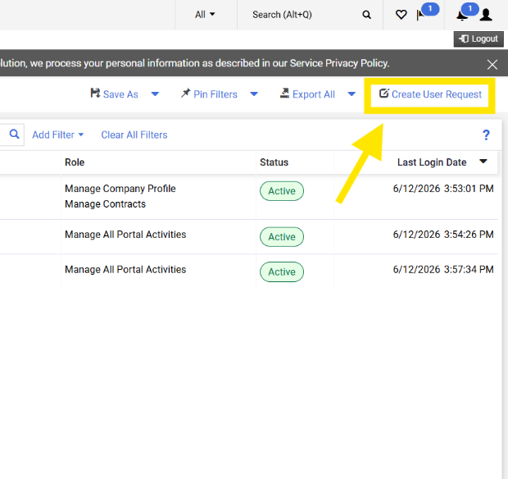
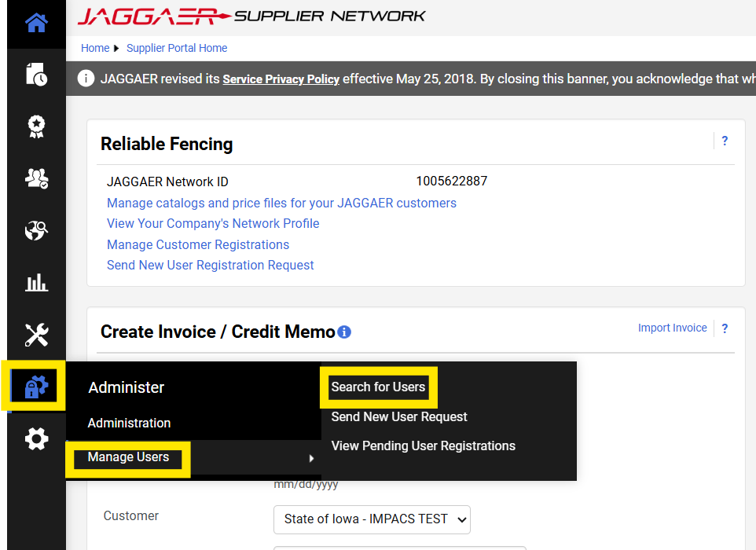
Adding Users: search for existing users
1
Navigate to Administer > Manage Users > Search for Users to make sure the user is not already registered.
2
If they are not listed, click Create User Request

Slide 14
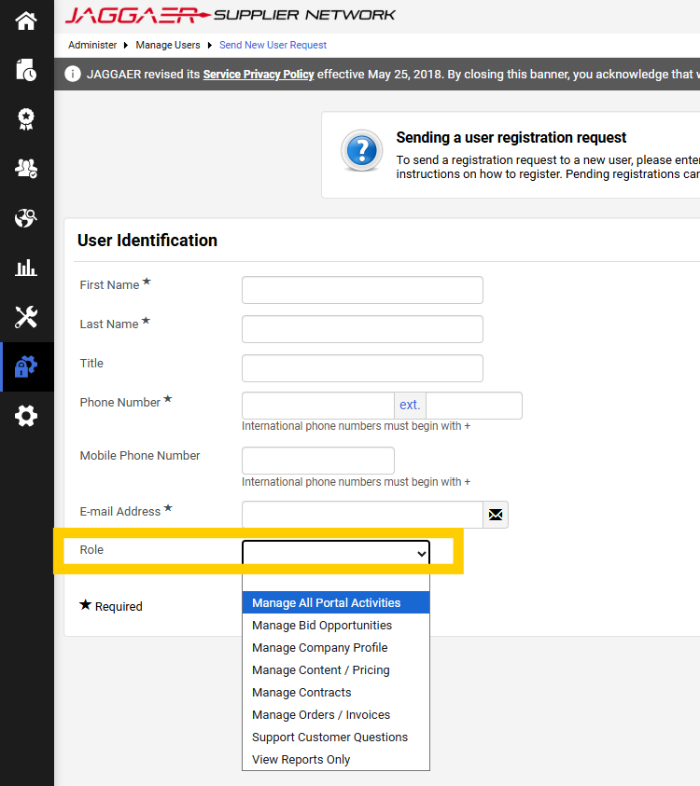
Adding Users: send new user request
3
Fill in the required information
Add a Role – Manage All Portal Activities allows the user to reply to bids in IMPACS
Click Send User Request
4
5
Tips:
Completing your JSN profile can help other Jaggaer customers find your business
Learn more about managing your JSN profile here

Slide 15
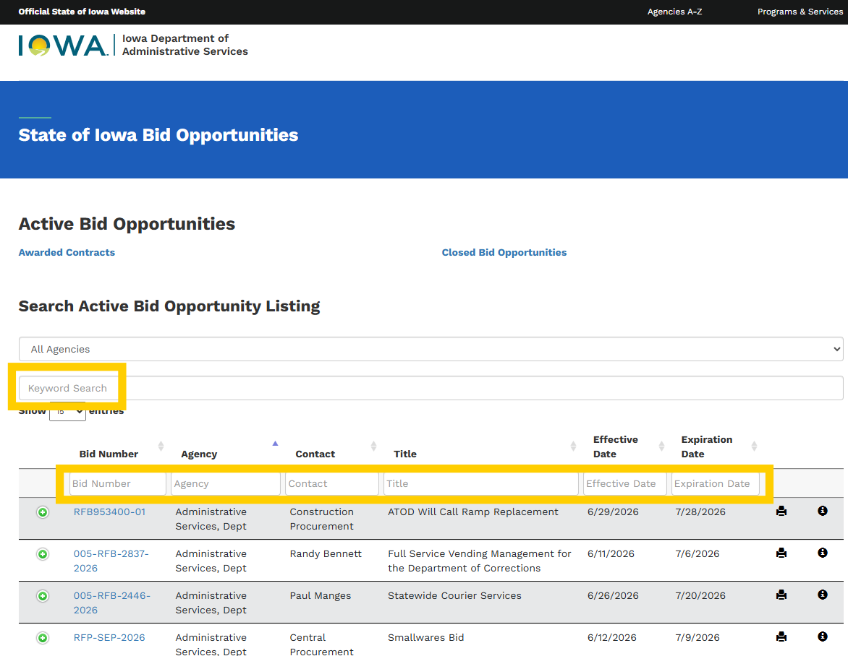
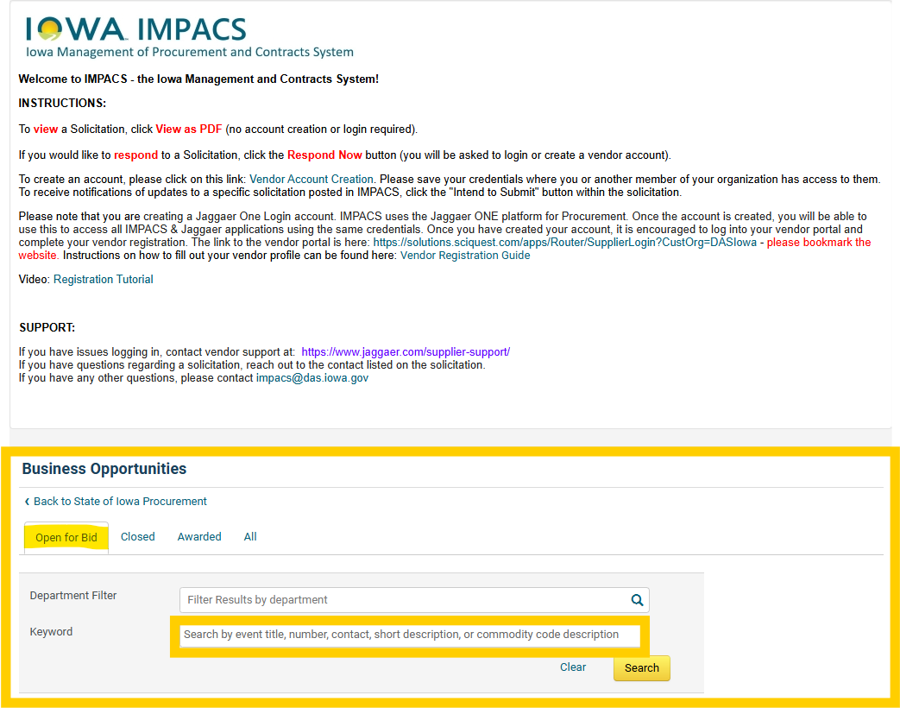
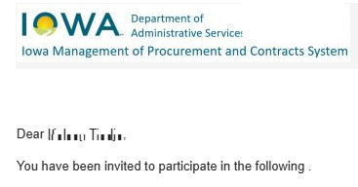
Finding Events: three ways
RFQ
Request for Quote
1
IMPACS public site
2
BidOps public site
RFB
Request for Bid
RFP
Request for Proposal
3
Email invite by registered commodity code

Slide 16
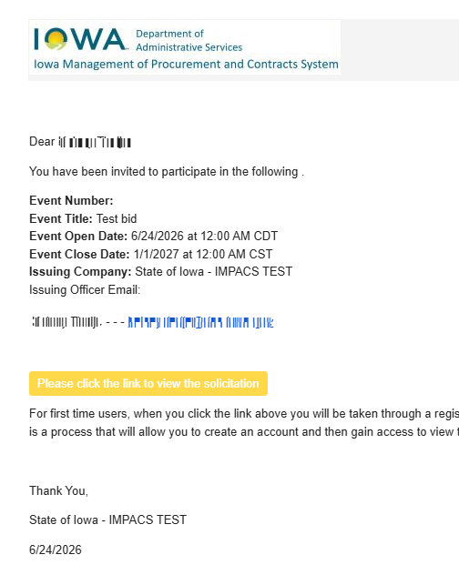
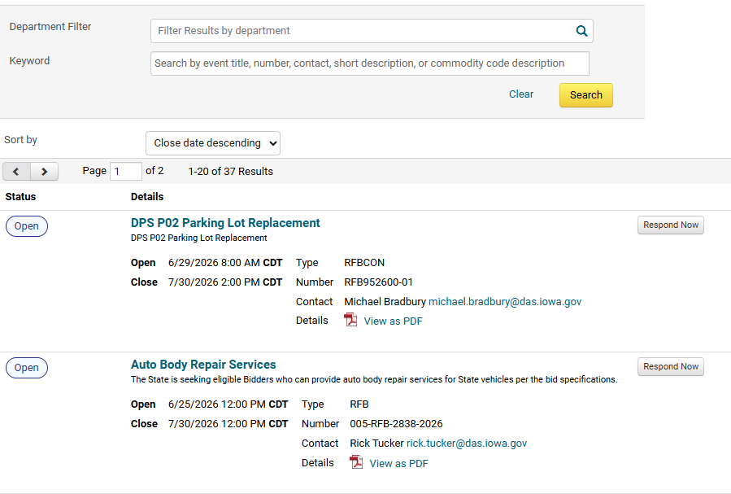
Responding to Events: access two ways
Via email invite
Via IMPACS public site
1
2
Notes:
Even if you receive automatic notifications through your commodity code selections, I would recommend checking the public site periodically to make sure you don’t miss anything.

Slide 17
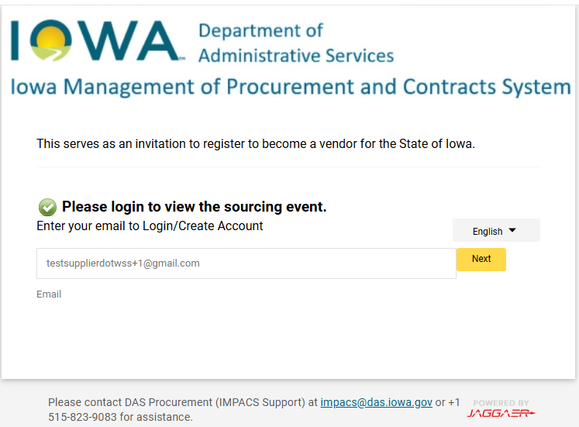
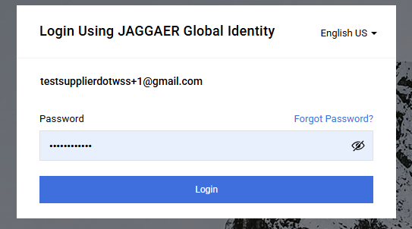
Responding to Events: log in
Enter email, click Next
Enter password, click Next
    [or click Forgot Password]
You may be prompted for a security code if you haven’t logged in recently
Tips:
Check spam for security codes and password reset links. It may take a few minutes
Always use the most recent code
Issues? Contact support:
DAS 515-823-9083 impacs@das.iowa.gov
Jaggaer 1-800-233-1121
    Jaggaer online support

Slide 18
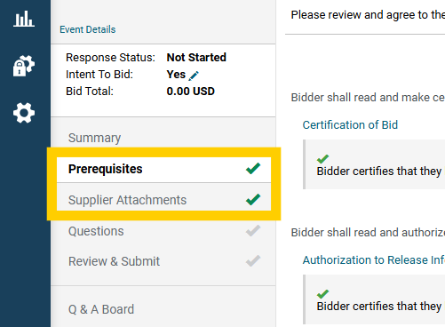
Responding to Events: required fields
You must click Yes, I intend to Bid before entering responses.
Some Prerequisites are required to view bids or enter a response. Complete all required Prerequisites before proceeding.
Green checkmarks indicate sections have been completed

Slide 19
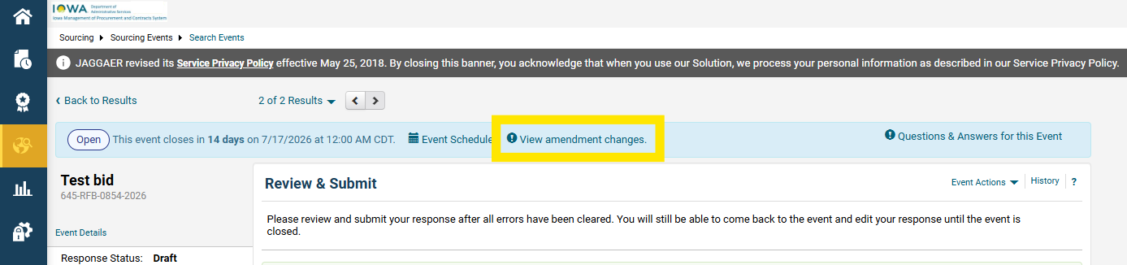
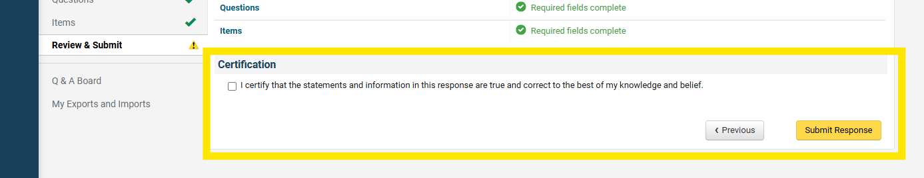
Responding to Events: amendments
1
View Amendment changes. If you’ve started a response, you will automatically get notified when there’s an amendment.
You MUST recertify and submit your response after an amendment. The system saves the rest of your responses previously submitted.
2

Slide 20
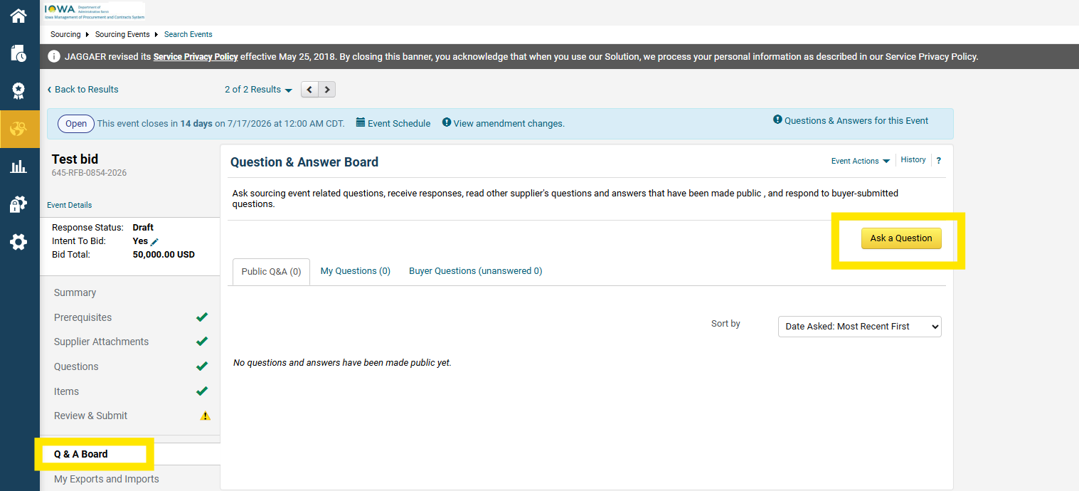
Responding to Events: Q&A
Navigate to Q&A
Click Ask A Question
1
2
Fill in the required fields and Submit Question
3

Slide 21
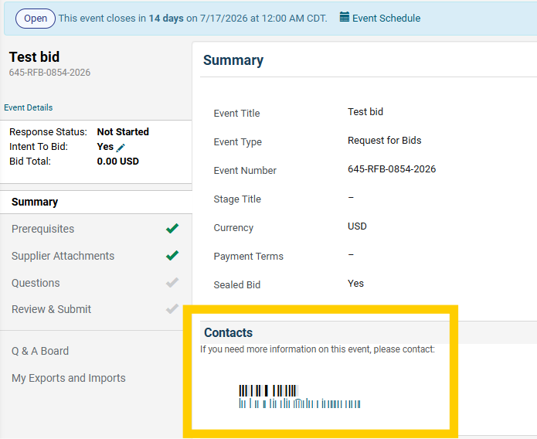
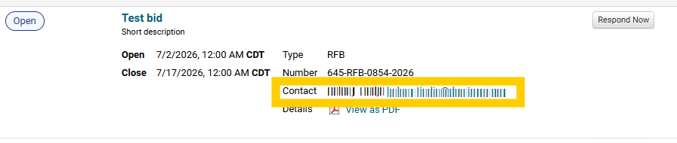
Responding to Events: support
Questions about solicitation content?
Contact the Procurement Specialist listed on the event
Technical issues with IMPACS?
Contact support:
DAS 515-823-9083 impacs@das.iowa.gov
Jaggaer 1-800-233-1121
    Jaggaer online support

Slide 22
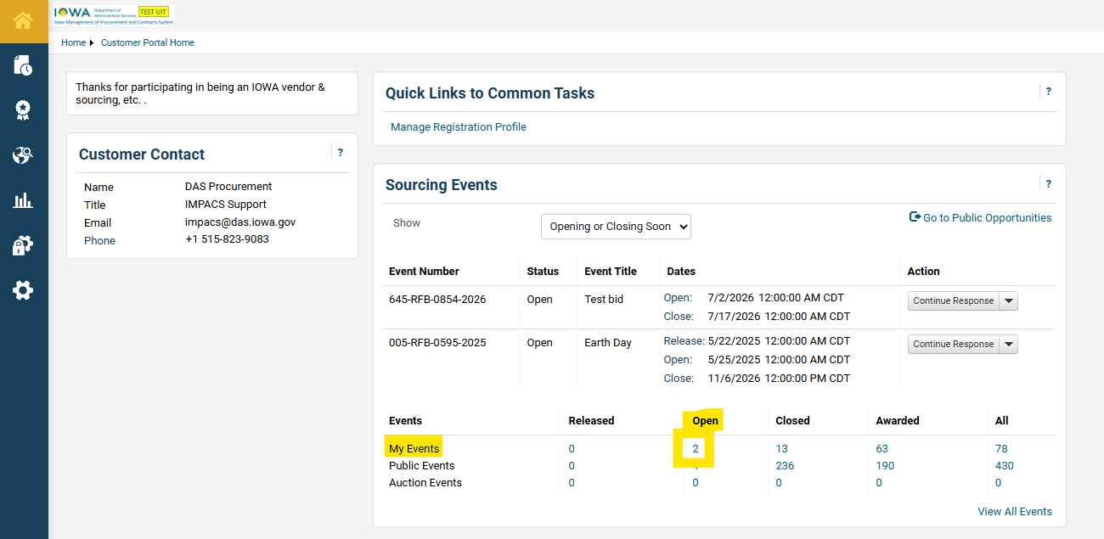
Returning to an Event
From your IMPACS home screen, navigate to My Open Events
If there are none listed, try searching All Events

Slide 23
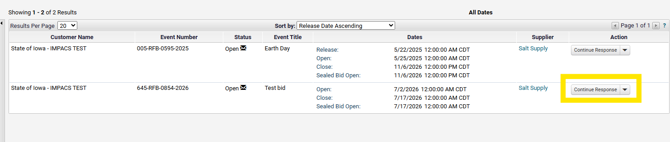
Returning to an Event
Find your event and click Continue Response

Slide 24
Support
Questions about solicitation content?
Contact the Procurement Specialist listed on the event
Technical issues with IMPACS?
Contact support:
DAS 515-823-9083 impacs@das.iowa.gov
Jaggaer 1-800-233-1121
    Jaggaer online support

